Slide 1

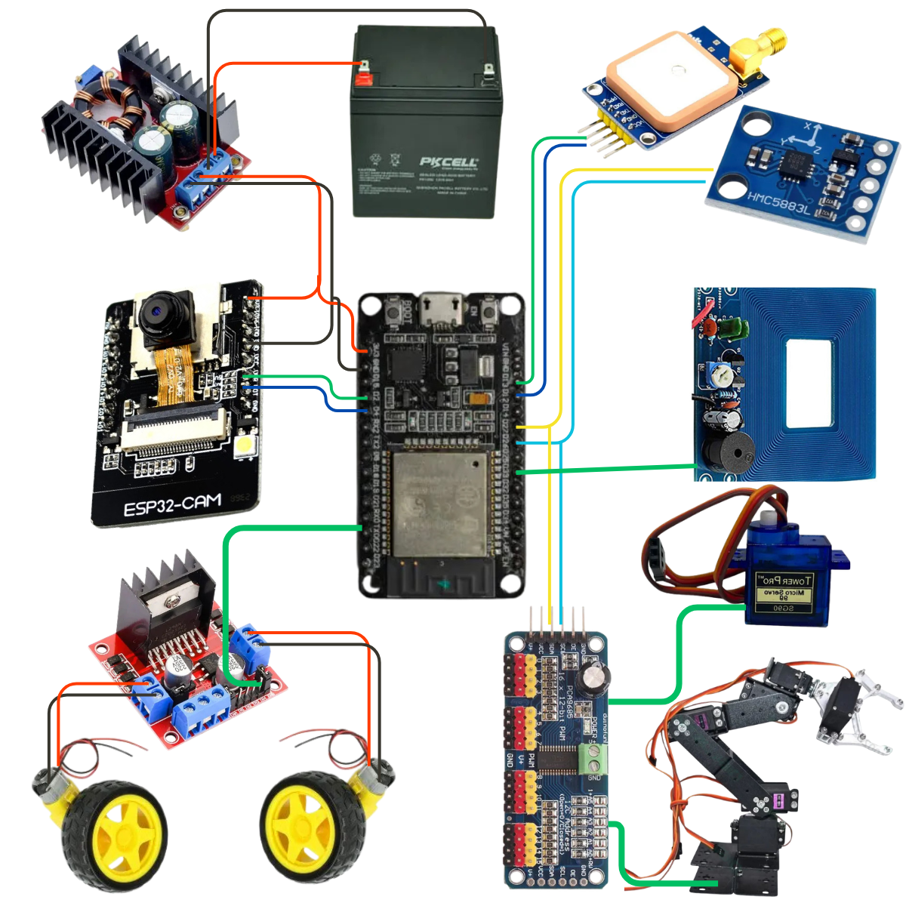
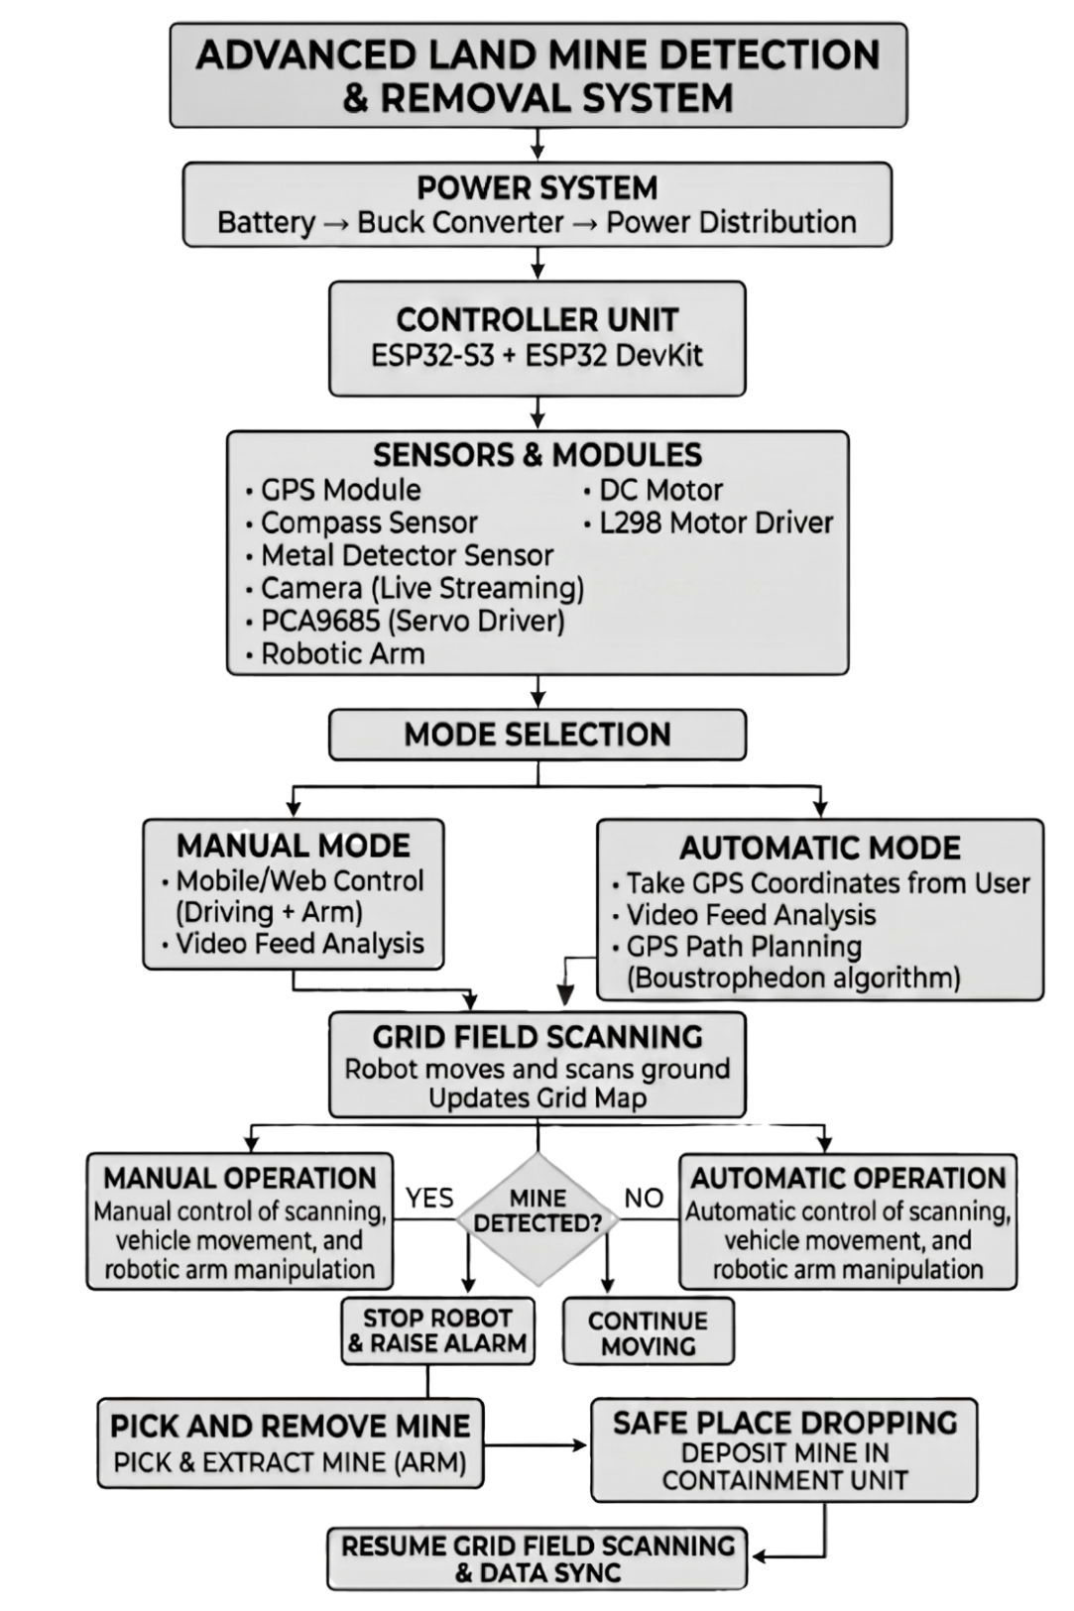
Intelligent VISION-BASED MANUAL/Automatic Robotics Manipulator
Imran Nazir (F22BINCE1M02021), Muhammad Zulqarnain (F22BINCE1M02001), and Waqas Ajaz (F22BINCE1M02006)
{021engr.imran, alkarimroboticsofficial, itwithwaqas}@gmail.com
DEPARTMENT OF INFORMTION AND COMMUNICATION ENGINEERING
BS Intelligent Systems and Robotics
The Islamia University of Bahawalpur, Pakistan
Introduction
Systematic Diagram
Experimental Results and Discussion
Landmines remain a severe hazard in many regions, making conventional detection methods dangerous, time-consuming, and heavily dependent on human effort.
To eliminates human risk by using an advanced robot to detect metallic objects autonomously or via remote control.
Dual microcontrollers, live visuals, and automated marking make this landmine clearance system faster and safer..
Dual controllers ensured stable video and fast control.
UART bridge proved reliable for seamless data exchange between the web server and the hardware control nodeRobot accurately detected metallic objects.
Emergency stop reacted instantly on detection.
The robotic arm flawlessly executed its sequence, confirming perfect sensor-actuator coordination
Project Objectives
Develop a reliable and low-cost robotic platform for landmine detection
A dual-microcontroller architecture efficiently balances web hosting, video streaming, and hardware control.
Feature Dual-Mode Camera-assisted Manual and automatic operation.
Achieve real-time coordination to stop movement and activate the manipulator arm.
Conclusion and Perspectives
Conclusion
Proposed Method
The developed dual-ESP system successfully bridges the gap between low-cost hardware and complex safety logic.
By providing both camera-guided Manual and GPS-guided Automatic modes, the robot offers immense flexibility for different operational terrains.
This project drastically enhances safety and reduces human involvement in preliminary landmine detection tasks.
The system consists of both hardware and software.
System Architecture
Robot Operation Workflow
Distributed processing for efficiency and stability.
ESP32-S3 CAM: Handles web dashboard, user input, and live video streaming.
ESP32 DevKit: Controls sensors, manipulator arm, and real-time tasks via FreeRTOS.
UART Bridge: Transfers commands and alerts between both controllers.
L298N Driver: Provides precise movement and turning control
Manual Mode: Dashboard controls robot live.
Automatic Mode: GPS guides autonomous navigation.
Continuous Scanning: Metal detector runs always.
Future Direction
Integrate OpenCV with ESP32-S3 for visual threat detection.
Enhancing autonomous navigation accuracy using RTK (Real-Time Kinematic) GPS systems.
Upgrade sensors for deeper soil detection.
Metal Detection Process
Acknowledgement
Metal detector scans ground continuously.
ESP32 processes detection instantly.
L298N stops robot immediately.
Project Cost
Description | Cost in (PKR)
System Architecture (Sensors, Power Supply) | 20,000/-
Control & Decision Logic (ESP32) | 3000/-
Robotics Manipulator | 15,000/-
Mobile Platform | 7000/-
Miscellaneous (Wires, Soldering, Connectors, Housing, etc.) | 5000/-
Total | 50,000/-
The work was carried out independently by the authors with their own effort and initiative.
Manipulator Activation
Supervisor:
Dr. Zain Ul Abiden Akhtar(Assistant Professor)
Information and Communication Engineering Department
Email: engr.zain@iub.edu.pk
Automatic Action: Arm activates after stop to mark or inspect target.
Manual Trigger: Operator controls arm via dashboard using live camera feed.
Final Year Project Exhibition, 4 Mat 2026, Faculty of Engineering, The Islamia University of Bahawalpur, Pakistan.

